Slide 1
Lecture 24:
Software Quality and
Software Maintenance (2)

Slide 2
Developing Quality Software
Outline
• What is quality?
• Achieving quality
• Connection between product and process
• Technical Reviews
• Quality, cost and time
• Quality and efficiency
• Maintaining and controlling quality

Slide 3
What Are Reviews?
a meeting conducted by technical people for technical people
a technical assessment of a work product created during the software engineering process
a software quality assurance mechanism
a training ground

Slide 4
What Reviews Are Not
A project summary or progress assessment
A meeting intended solely to impart information
A mechanism for revenge

Slide 5
The Players of Review
review
leader
standards bearer (SQA)
producer
recorder
reviewer
user rep

Slide 6
Conducting the Review
1.
be prepared—evaluate
product before the review
2.
review the product, not
the producer
3.
keep your tone mild, ask
questions instead of
making accusations
4.
stick to the review agenda
5.
raise issues, don't resolve them
6.
avoid discussions of style—stick to technical
correctness
7.
schedule reviews as project tasks
8.
record and report all review results

Slide 7
Review Guidelines
ID problem areas
Limit debate and rebuttal
Limit the participants
Enumerate the issues
Identify costing sources

Slide 8
Cost of Quality
Prevention costs include
  quality planning
  formal technical reviews
  test equipment
  Training
Internal failure costs include
  rework
  repair
  failure mode analysis
External failure costs are
  complaint resolution
  product return and replacement
  help line support
  warranty work

Slide 9
Why SQA Activities Pay Off?
cost to find
and fix a defect
100
60.00-100.00
10.00
-
15.00
10
3.00
1.50
1.00
1
0.75
Design
test
field
Req.
system
use
code
test

Slide 10
Quality, Cost and Time
Given certain resources, the best we can do is to deliver a product of a particular quality for a certain price by a stated deadline.
However,
If we wish to increase quality, we also increase price
and/or time to deliver
If we wish to reduce price, this must be at the cost of
quality and/or delay in delivery
If we wish to bring the deadline forward, then quality is
lost or price rises.
Furthermore, there is no guarantee that taking such steps will achieve our desire. For example, adding people to a late project may make it later.

Slide 11
Quality, Cost and Time
High Quality
Short Time to Deliver
Low Cost
Moving towards a goal (low cost, perhaps), means moving away from other goals (quality or time).

Slide 12
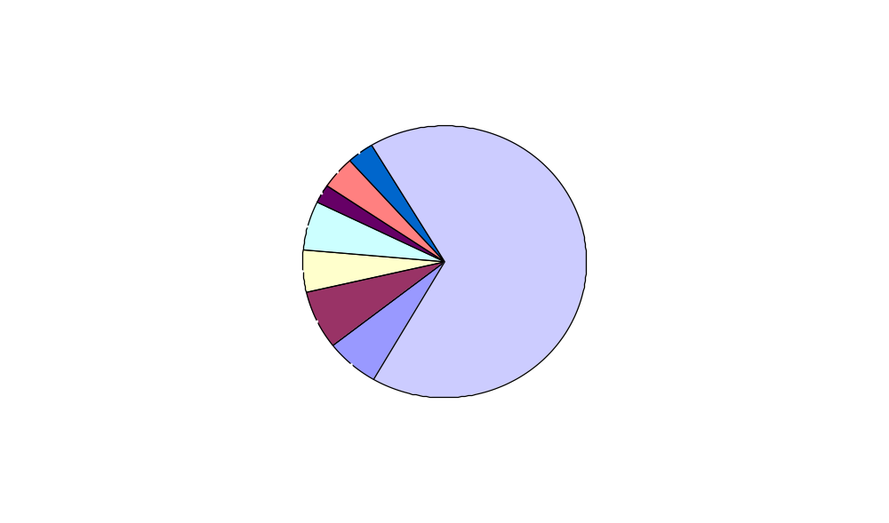
Software Maintenance – Life Span Work Distribution

Slide 13
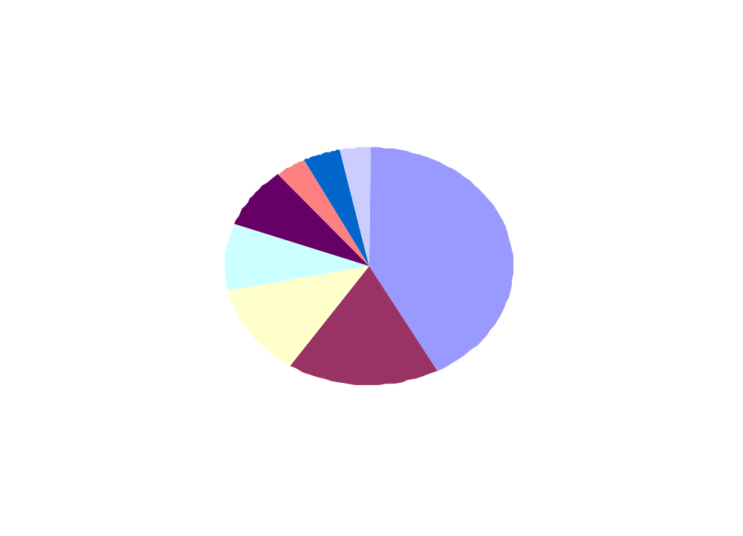
Maintenance Breakdown

Slide 14
Characteristics of Maintenance
Activities required to accomplish maintenance
• Structured or unstructured maintenance
• In structured maintenance, we evaluate the design and
plan changes, modify the design and implement the
changes.
• In unstructured maintenance, we review the code, and
recode.
Costs
• Increasing
• Backlog
• Customer dissatisfaction, reduction in quality,
upheaval of staff

Slide 15
Characteristics of Maintenance (cont.)
Problems
Difficult to trace changes in software
Difficult to trace the process of creation of software
Difficult to understand someone else’s program
Documentation is bad or non-existent
Software is not designed for change
Maintenance is seen as low-grade work

Slide 16
Maintainability
Factors
Availability of qualified staff
Understandable system structure
Ease of system handling
Use of standardized programming languages and operating systems
Standardized structure of documentation
Availability of test cases
Built in debugging facilities
Availability of a suitable computer

Slide 17
Readings
Chapter 26: Quality Management (Pressman 6th edition)
or
Chapter 8: Software Quality Assurance (Pressman 5th edition)

